Slide 1
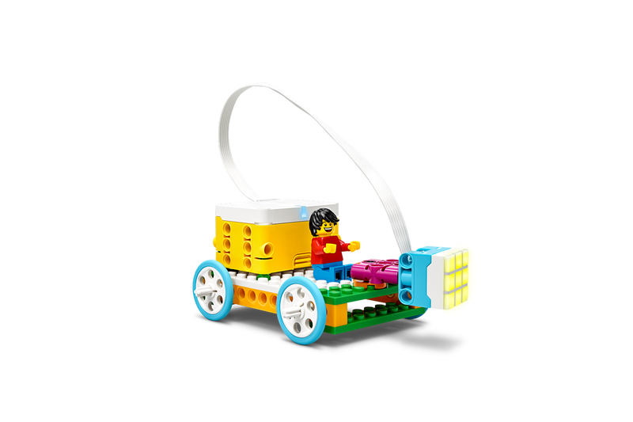
Engaging in Argument from Evidence

Slide 2
Teacher Notes
The activity modeled here is an extension of the original lesson How Eyes See (lego.com), focusing on constructing an argument from evidence, and can be combined with the original lesson and build.
By the end of the lesson, the students will be able to
Identify objective evidence
Distinguish evidence from inference or opinion
Make inferences from evidence
Establish a claim from evidence and inference (reasoning)
Construct a CER (Claim-Evidence-Reasoning) written response
NOTE:
A CER is a written student PRODUCT that is structured as
Claim, Evidence, Reasoning.
The PROCESS of creating a CER begins with Evidence from which students make inferences and use Reasoning to develop the Claim.

Slide 3
Daniel enters a dark cave. This is what he sees.
Notes:
Ask your students why they think this image is here. On the next slide, you will record student responses.

Slide 4
What I See (evidence) | What I Think (reasoning)
(The cave is black.) | (It is too dark to see.)
(The cave is completely dark.) | (There is no light in the cave.)
(I only see a black box.) | (There is nothing there.)
Daniel enters a dark cave.
Notes:
Be sure to delete the sample student responses before using chart with students.
Key here is having students start with observable, objective evidence—and distinguishing that from why they think that’s important or what they think that means.
The next step is to make inferences (reasoning) about that evidence.
This is very difficult even for adults!

Slide 5
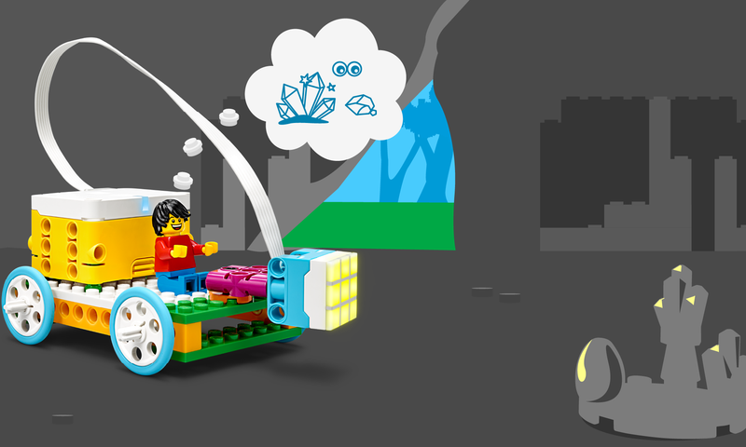
Daniel, now in his cave car, finds something while exploring the dark cave.
Notes:
Ask your students why they think this image is here and what details they see. On the next slide, you will record student responses.

Slide 6
What I See (evidence) | What I Think (reasoning)
(The cave is black.) | (It is too dark to see.)
(The cave is completely dark.) | (There is no light in the cave.)
(I only see a black box.) | (There is nothing there.)
(I can see the outside.) | (It is light outside so we can see what is there.)
(Daniel sees rocks and crystals.) | (The light from Daniel’s cave car and the outside lets him see what is in the cave.)
(Light is on the left side of the rocks and crystals.) | (Light from the cave car is reflecting off the rocks and crystals.)
Daniel, now in his cave car, finds something while exploring the dark cave.
Notes:
Be sure to delete the sample student responses or create a blank copy before using chart with students.
Repeat the same exercise with the illuminated cave image. See if there are opportunities to refine student thinking (e.g. “There is nothing there” turned out not to be accurate—and that’s GREAT! Additional evidence doesn’t mean we were wrong—we just needed more information.)
Depending on your purpose for doing this lesson, student responses can also include science content and vocabulary such as Eyes, Light, Reflection, Surface.

Slide 7
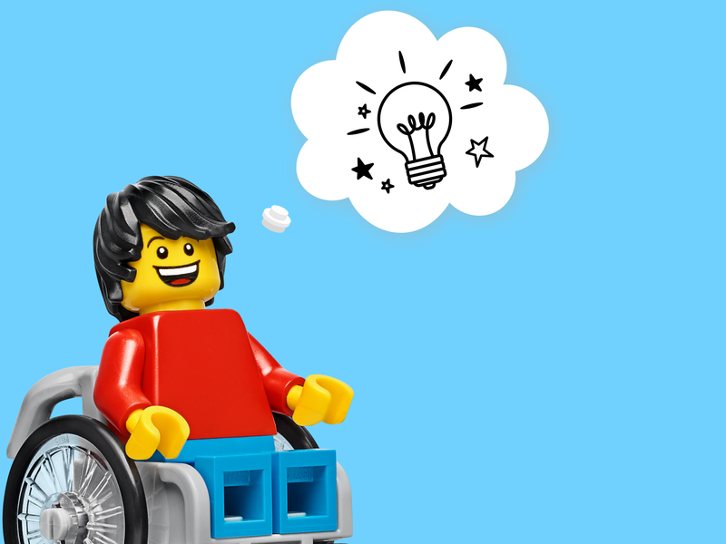
Write a statement about how we can see objects in a dark environment.
Notes:
Using the evidence and reasoning from the chart activity, help the students write a claim about how objects can be seen in a dark environment.

Slide 8
Sample Statements: We can see objects in the dark only when there is a source of light. We need light to see objects in the dark.
Notes:
Using the evidence and reasoning from the chart activity, help the students write a claim about how objects can be seen in a dark environment.
Depending on your purpose for doing this lesson, student responses can also include science content and vocabulary such as Eyes, Light, Reflection, Surface.

Slide 9
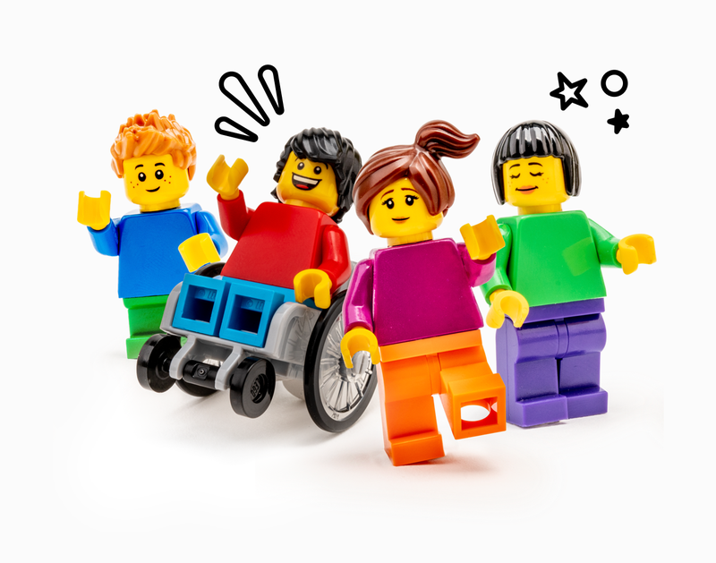
Write a Claim-Evidence-Reasoning (CER) response. C=Claim from our statement of what we think is true from Slides 9, 10. E=Evidence from our “I See” column, Slides 6, 8. R=Reasoning from our “I Think” column, Slides 6, 8.

Slide 10
We need light to see objects in the dark. When the cave was completely black, it was too dark to see. The light from the cave car reflects on the things inside the cave. This light lets Daniel see the rocks and crystals in the cave.
Notes:
Depending on your purpose for doing this lesson, student responses can also include science content and vocabulary such as Eyes, Light, Reflection, Surface.

